Slide 1
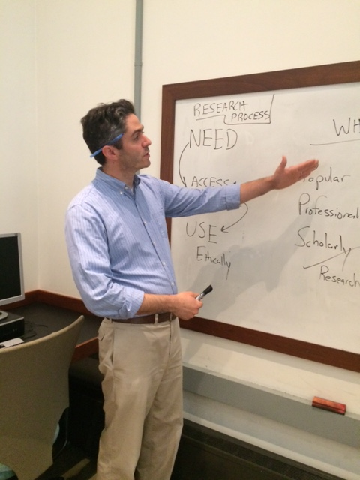
Information Literacy Module for FYI Available to any FYI Tony Penny, Research Librarian – Goddard Library
October 2014
Orienting to College
Engaging with scholarship requires inquiry
Accessing the greater information landscape requires research & library navigation skills
Creating new knowledge has value and ethical responsibilities
LEEP Learning Outcome #2: Intellectual & Practical Skills: Information Literacy
 | ORIENT | EXPLORE | ACT
STUDENT BEHAVIORS | I can ask engaging questions. I can take a question and begin to assimilate it with subject areas and create keywords. I can read & inquire about things I am unfamiliar with. | I can explore the online library with fundamental direction I can explore the physical library with fundamental direction. I can evaluate the "who" and "what" of the information I find. | I can incorporate new knowledge into a written or oral presentation. I can cite the information I used in a standard format. I can initiate my own research and use research librarians when needed.
FOUNDATIONAL/ HIGH IMPACT EXPERIENCES | Based on a research assignment: List as many questions as possible with topic in mind. Use "who, what, where, when, why & how” to start building keywords. Use credible reference sources to fill any knowledge gaps. | Practice searching online databases. Practice using the library. Determine the “who” and “what” of the sources found. | Complete the assigned research assignment. Create a properly formatted bibliography. Use a Research Librarian for assistance.
Ways to Link the Module into an FYI
No two FYI courses are alike. We encourage you to contact Tony Penny at apenny@clarku.edu to determine the best way to integrate the information literacy learning outcome into your FYI.
We encourage students to become oriented with the library, library services, and basic online databases during their first semester.
Information Literacy Rubric*
LEARNING OUTCOMES | Undeveloped 1 | 1.5 | First Years 2 | Majors 2.5 | Capstone 3
IDENTIFY the question, problem or issue | Research question is too broad with undeveloped or no thesis statement. Keywords, subject terms, and/or main ideas related to the topic are missing. |  | Research question and/ or thesis statement is narrowed in focus. Identifies some relevant keywords, subject terms, and main ideas related to the topic. |  | Research question and/ or thesis statement is focused and effective. Demonstrates no lack of relevant keywords, subject terms, and main ideas related to the topic.
ACCESS the needed information | Accesses information randomly using popular and some professional resources. |  | Accesses information with a simple search strategy. Uses popular, professional and scholarly resources with some variety of format. Demonstrates ability to refine search. |  | Accesses information using effective, well-designed search strategies by acknowledging the value and difference of potential resources in a variety of formats. Balances popular, professional and scholarly resources as needed.
EVALUATE information and its sources critically | Chooses a few information sources. Selects sources using limited criteria (such as relevance to the research question.) |  | Chooses a variety of information sources appropriate to the scope of the research question. Selects sources using multiple criteria (such as relevance to the research question, currency, and authority.) |  | Chooses a variety of information sources appropriate to the scope and discipline of the research question. Selects sources after considering the importance (to the researched topic) of the multiple criteria used (such as relevance to the research question, currency, authority, audience, and bias or point of view.)
USE information effectively to accomplish a specific purpose with ethical and legal awareness | Communicates information from sources. Intended purpose not achieved. Citations and references are incorrect or missing. Resources cited demonstrate no breath of research. |  | Communicates and organizes information from sources. Intended purpose achieved. Citations and references are used in required format with minor lapses. Resources cited demonstrate some breath of research. |  | Communicates, organizes, and synthesizes information from sources. A specific purpose has been fully achieved. Citations and references are used correctly in required format. Resources cited demonstrate strong breath of research.
*This rubric is modeled on the AAC&U Information Literacy VALUE Rubric and uses elements from the Association of College and Research Libraries (ACRL) IL competency standards and framework.
Teaching students to navigate the
Research Process
Research & Library Instruction Services
We support the academic curriculum and promote the library as a co-curricular experience.
With a focus on students and the faculty who teach FYI, we can advise and assist in building First Years’ information literacy within the academic environment of any FYI course.
IDENTIFY
ACCESS & EVALUATE
USE Ethically
Approaches First Years’ Benchmark
Approaches Capstone Benchmark

